Slide 1

Advanced Programming Final Project
Author: Yonatan Kupfer

Slide 2

Background of the Project
Objective: Develop a distributed system for mathematical operations using agent-based processing.
Motivation: Explore and implement advanced programming techniques in Java.
Scope: Backend processing using Java. Frontend visualization using HTML, CSS, and JavaScript.
Application: Users can upload configuration files and input data. View real-time results through tables and graphs.

Slide 3
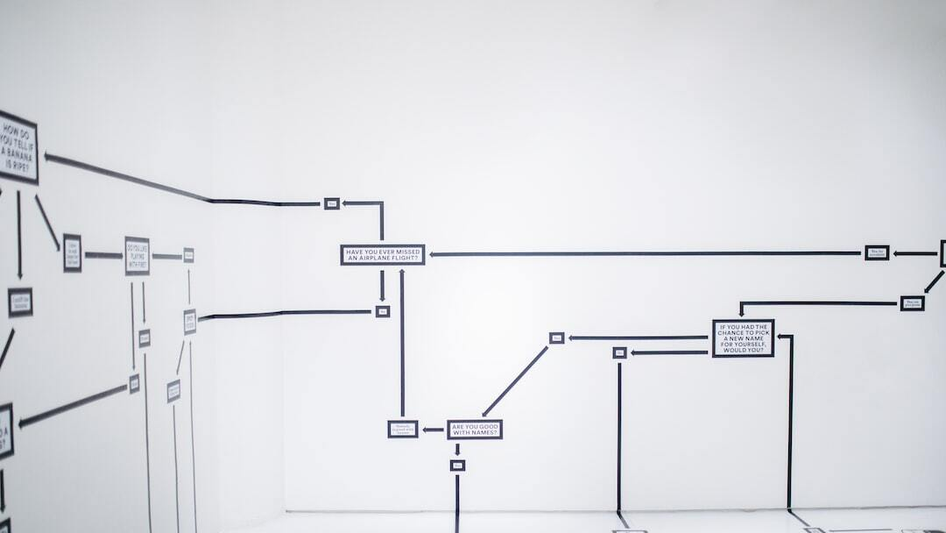
Design of the Project
Architecture: Backend: Java-based agents perform mathematical operations. Frontend: HTML, CSS, and JavaScript provide a user-friendly interface.
Components: Agents: PlusAgent, MinusAgent, MultiplyAgent, DivideAgent, etc. Configuration Management: Manages configuration settings. Core Logic: Handles message passing and graph representation. HTTP Server: Manages HTTP requests and responses. Utility Classes: Support HTML loading and graph writing.
Interaction Flow: 1. User uploads configuration file and inputs data. 2. Backend processes the data. 3. Frontend displays results in tables and visualizations.

Slide 4
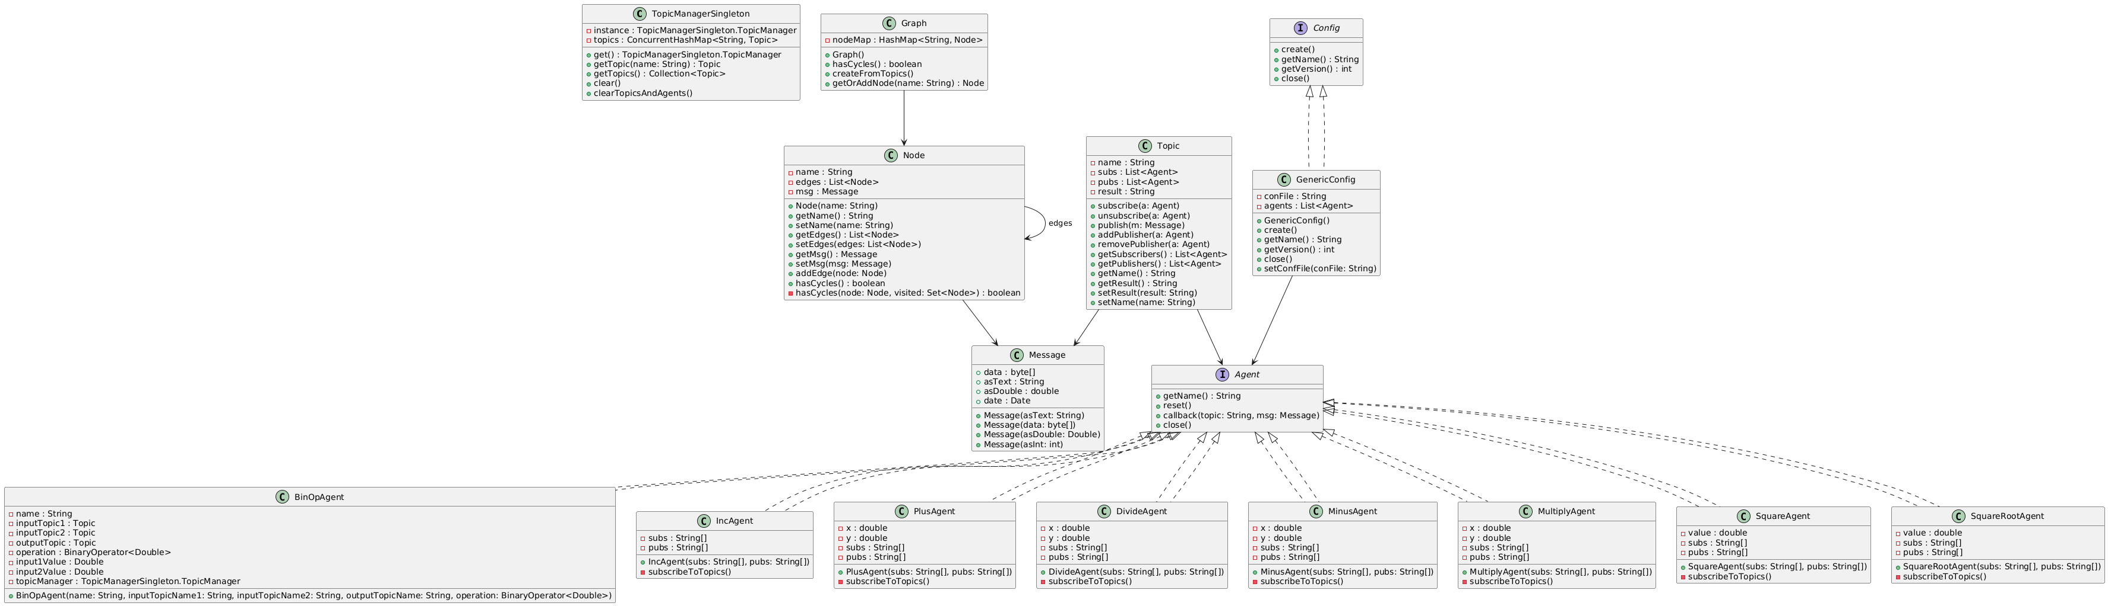
Model Layer UML

Slide 5
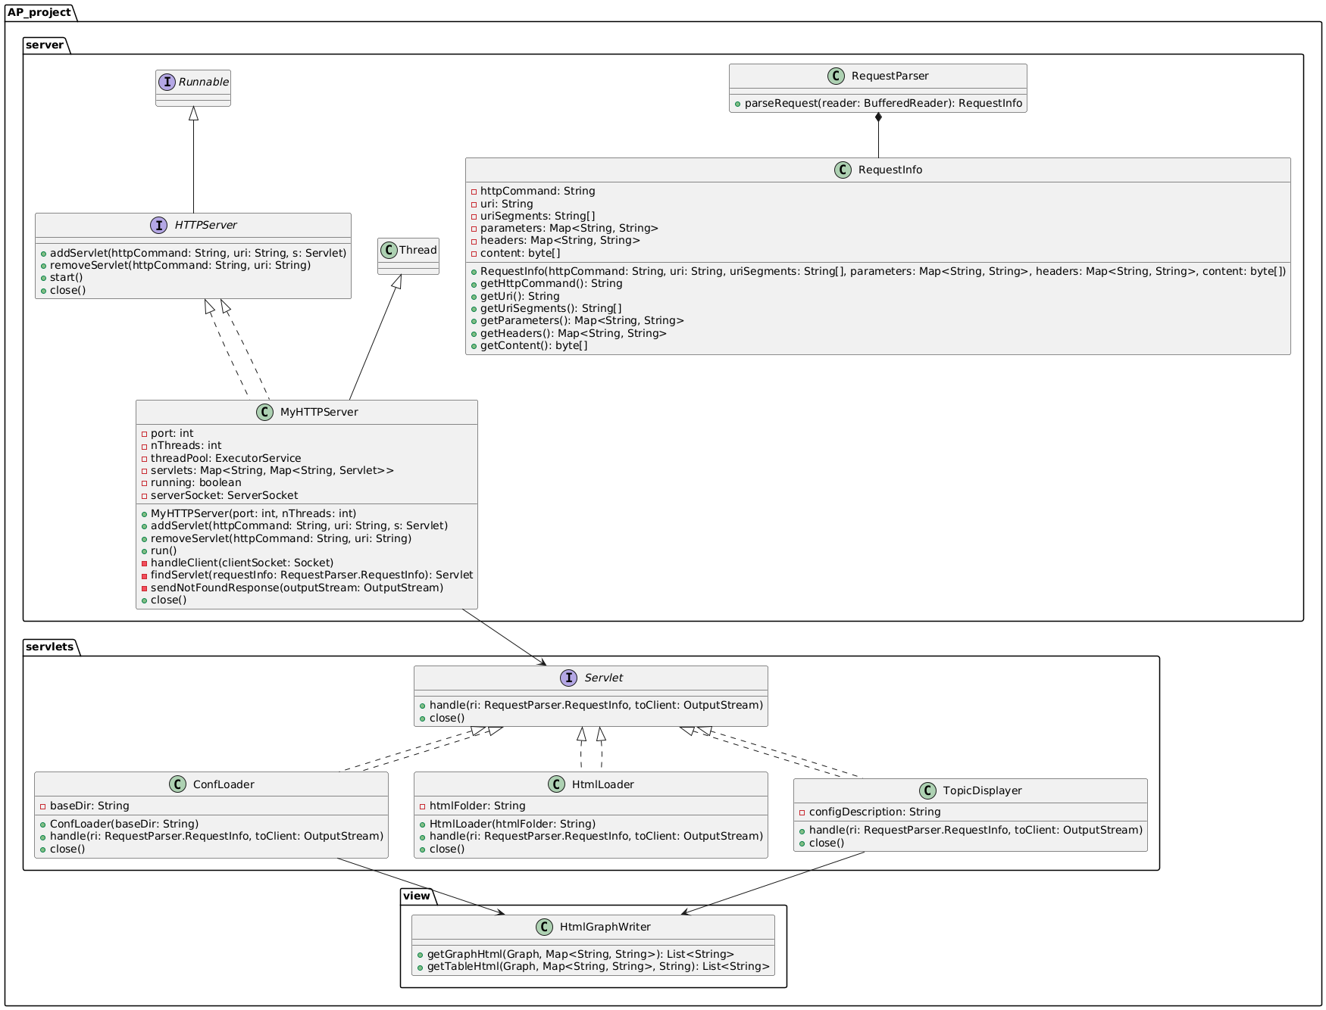
Control Layer UML

Slide 6

Summary of Learnings
Technical Skills: Advanced understanding of Java and agent-based processing. Frontend development with HTML, CSS, and JavaScript. Effective integration of backend and frontend components.
Project Management: Importance of a clear architecture design. Best practices in configuration management and code organization.
Personal Growth: Enhanced problem-solving skills. Improved collaboration and communication within a project team. Deeper appreciation for iterative software development.
Future Application: Applying knowledge and experience to future software projects for efficient execution.

